Slide 1

Writing Your Professional CV
BTC Apprenticeship & Work Experience Team

Slide 2

Your Professional CV
Your own personal marketing tool.
It outlines your qualifications, employment/work experience, strengths & achievements.
It's often the first document an employer will see – first impressions count!
A fluid document, one that should be constantly evolving & enhanced.

Slide 3

Can you describe yourself in 3 words?
Before you start writing your CV, it’s useful to carry out some self assessment.
Your CV is a tool you'll use to sell yourself, so the language you use in it should reflect you in a positive way.
Thinking of 3 words to describe yourself is a good place to start when considering how you can sell yourself, what makes you unique and what you have to offer.
This question could also come up in an interview.

Slide 4
Examples of words you could use.....
Able
Capable
Confident
Conscientious
Consistent
Determined
Diligent
Dynamic
Effective
Efficient
Energetic
Enterprising
Enthusiastic
Hard-working
Industrious
Loyal
Methodical
Motivated
Organised
Passionate
Persistent
Positive
Professional
Proficient
Reliable
Self-starter
Strong
Successful
Team player
Trustworthy
Vibrant
You can use these positive words throughout your CV

Slide 5
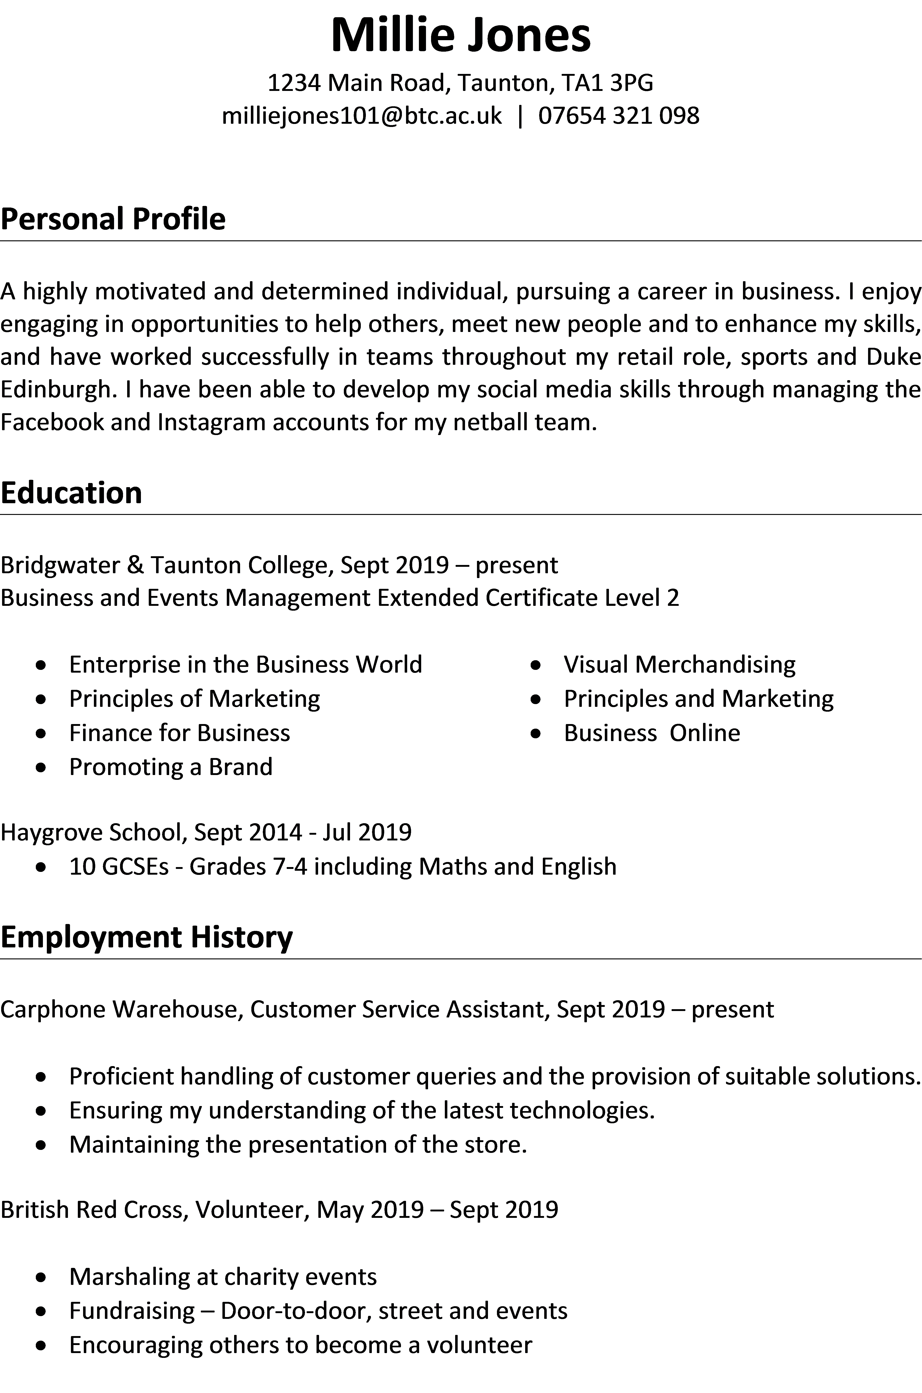
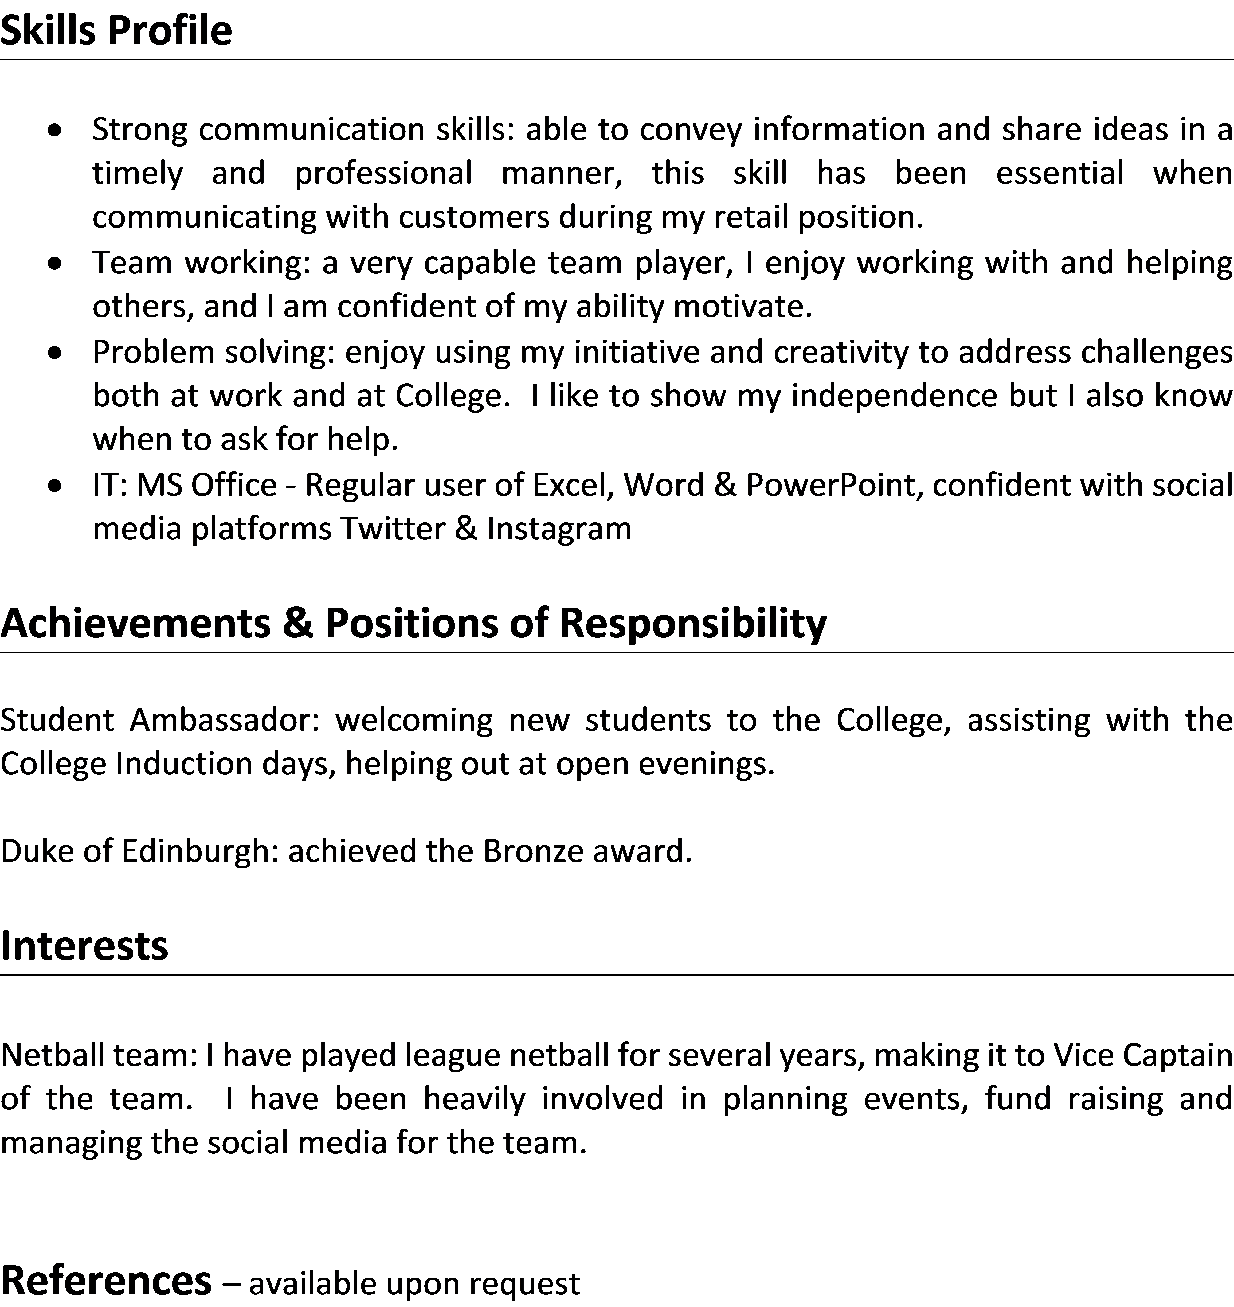
What a CV should look like.....
Your name at the top
Clearly defined sections
Displayed over 2 pages max
A summary of you as the first section

Slide 6

Some typical application processes…
CV only
CV & covering letter
Application form (online )
Application form & CV
How to apply
Email your CV and covering letter to....
Sometimes, employers will also ask you to provide a portfolio e.g. examples of your work.

Slide 7
What to Include in Your CV
The Essential Information
1) Name & contact details
2) Education & qualifications
3) Employment History / Work Experience
4) Skills
5) References
These will be the section headings
We’ll look at this section by section

Slide 8
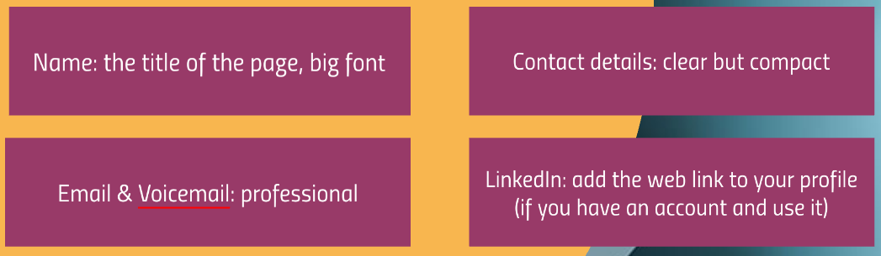
Contact Details
Add: your name, address, telephone number and email

Slide 9
Millie Jones
1234 Main Road, Taunton, TA1 3PG milliejones101@btc.ac.uk
07654 321 098
Example

Slide 10
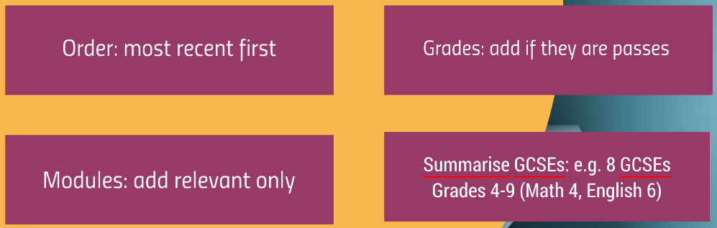
Education
Add: course titles & qualifications, place of study, dates, results/grades

Slide 11
Example
Education
Haygrove School, Sept 2014 - Jul 2019
10 GCSEs - Grades 7-4 including Maths and English

Slide 12
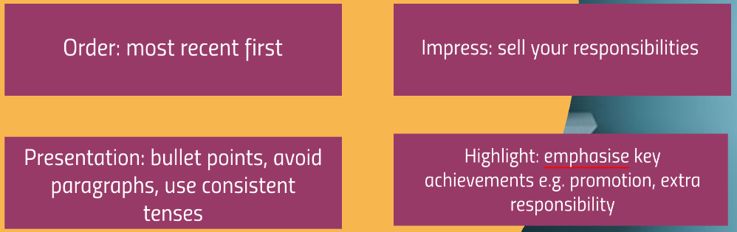
Employment History
Add: company, job title, dates, duties/responsibilities

Slide 13
Example
Employment History
Carphone Warehouse, Customer Service Assistant, Sept 2019 – present
Proficient handling of customer queries and the provision of suitable solutions.
Ensuring my understanding of the latest technologies.
Maintaining the presentation of the store.

Slide 14
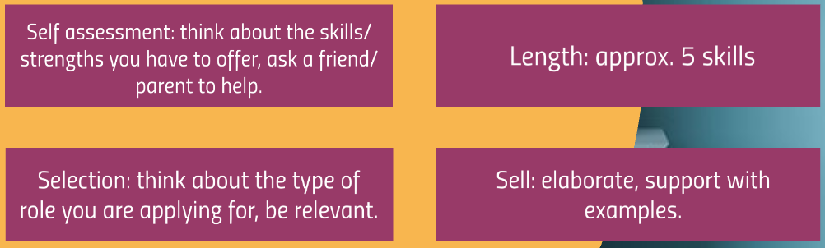
Skills
Add: soft skills, languages and technical skills

Slide 15
Skills Profile
Example
soft skills
Strong communication skills: able to convey information and share ideas in a timely and professional manner, this skill has been essential when communicating with customers during my retail positions.
.....and this is how you could include your IT skills
IT: MS Office - Regular user of Excel, Word & PowerPoint, confident with social media platforms Twitter & Instagram

Slide 16
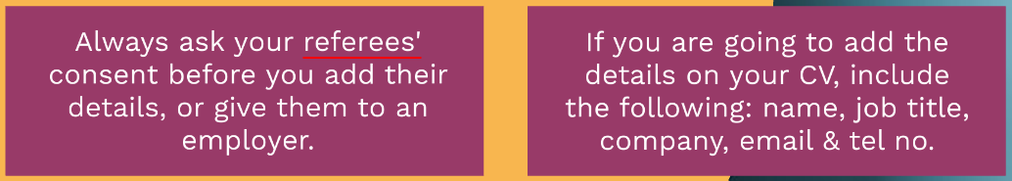
References
You can add the details of preferably two referees here or simply state "available upon request"

Slide 17
Desirable Information
The Extra Selling Points
1) Personal Profile/Summary
2) Volunteering
3) Achievements & Positions of Responsibility
4) Projects
5) Interests

Slide 18

Personal Profile
Add: a brief overview of your core strengths & experience. Think of this as a summary of your CV.

Slide 19
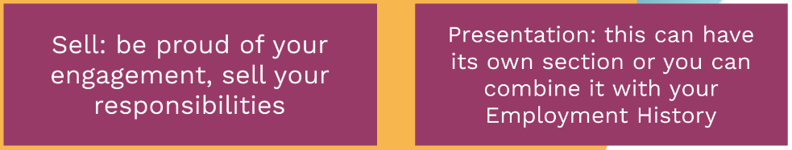
Volunteering
Volunteering shows you in a really positive light, always add this to your CV.
Add: opportunities you have engaged with, where you didn't get paid.

Slide 20

Achievements &
Positions of
Responsibility
Don’t undersell yourself, achievements are a really important part of your CV.
Add: examples that add value and demonstrate your skills, experience, and engagement.

Slide 21
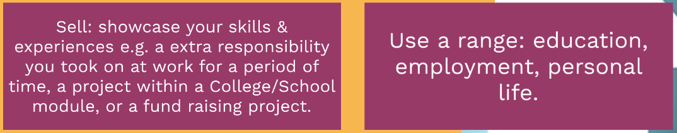
Projects
Add: examples of where/how you have applied your skills for a specific task/challenge.

Slide 22
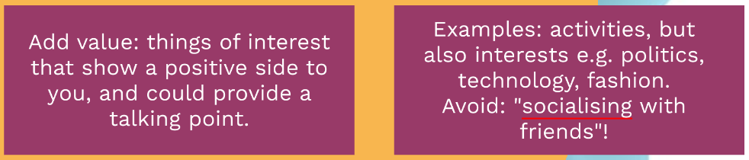
Interests
Add: your spare time & extra-curricular activities

Slide 23
Presenting Your CV
1-2 pages: Ideally 2 pages, try & fill the page, avoid large areas of blank space - use columns instead of long lists. If you can't fill 2 pages, reduce to one.
Ordering: Add the most important info on the front page.
Consistency: font type, size, line spacing, language.
Formatting: Emphasis text/headings, use professional alignment - tabs – NOT the space bar – show off your Word skills.

Slide 24
Top tip: Tailoring your CV
Tailor your CV to the type of job you are applying for, in particular, the following sections:
Personal Profile
Skills
Job role responsibilities
Projects
Interests
You could have several, slightly different versions of your CV

Slide 25
Sell Yourself
Responsibilities: Expand upon your work responsibilities
Achievements: be proud!
Convince: Add adjectives to describe your skills/competencies e.g. excellent, competent, proficient, confident etc.
Measurable: add quantifiable info e.g. fund raising - how much? Social media - how many followers?
Language: be professional, confident and positive!

Slide 26
Things to Avoid
Curriculum Vitae at the top: Instead add your name at the top, we know it's a CV.
Your photo: this is not required.
Waffling: you could have only 30 seconds to impress, be concise!
Discrimination: Info that does not promote equal opportunities e.g. race, gender, religion, age, nationality.
Mistakes: Spelling & grammar errors.

Slide 27
Applying for an Apprenticeship?
We’re here to help…….
Contact: apprenticehelp@btc.ac.uk
Looking for Work Experience?
Contact: Workexperience@btc.ac.uk

