Slide 1
Using the National Apprenticeship Service website (NAS)

Slide 2
What is NAS?
NAS is a National Government website where Training Providers and Employers advertise apprenticeship vacancies. This is a key way to find an employer.
Locating NAS
Just go to Google. Type ‘Find an Apprenticeship’ and you will find it here.

Slide 3
Use the filters accordingly to find what you are looking for
You can search by;
Employer
Reference number
Type or Level of apprenticeship
Location

Slide 4
The Vacancy Advert
Once you have found an apprenticeship to view, you will see it is broken down into sections.
The Apprenticeship Summary gives you information about the role with the employer, as well as essential information such as:-
the working week,
duration of the apprenticeship,
salary
potential start date.

Slide 5
The Vacancy Advert
The Requirements area is important, as this is the part you need to ensure you match. The employer is asking for these certain skills and qualities, do you have them?
You need to make sure you reach the Eligibility of an apprenticeship too.
Remember;
Level 3 = you ideally need C/4 in Maths and English GCSE
Level 2 = you do not need your Maths and English GCSE but may need to complete Functional Skills alongside the programme

Slide 6
The Vacancy Advert
Make sure you check out the Employer’s website and find out about the work they do. The employer will be impressed with your Application if you have taken the effort to look at the work they are involved in.
Check their location too and be sure you can get there!
Check the Training Provider! Remember this is a National site, so other Training Providers use this site to advertise their vacancies. If you just want to attend BTC, be aware of the training provider!

Slide 7
Set up and Account
NAS requires users to have an account to apply for vacancies, which you can either set up before you apply or during your application stage.
You can create an account via this section when you first go onto the National Apprenticeship Site. As you can see, you can set up alerts so you can always keep track of any new vacancies.
Alternatively, you can create an account when you apply. Select this button at the top of the vacancy.

Slide 8
Applying for the vacancy
Once you have made an account for NAS, you will then be ready to apply for the vacancy. This is what the top of the application form will look like.
You can view the full vacancy again by selecting ‘View apprenticeship’.
Your details will be added here. Please check they are correct as this information is used to make contact with you.

Slide 9
Applying for the vacancy
Education details are first.
Ensure you add details of your most recent school or college, including the dates.
Please make sure you always add your qualifications.
In particular, your Maths and English GCSE grades, as this helps check you reach the eligibility for the programme.
Also add any qualifications in relation to the apprenticeship as this could be a great advantage.
If you are still awaiting your GCSE grades because you are in Year 11, it’s a good idea to add your predicted grades.

Slide 10
Applying for the vacancy
If you have a job or completed any work experience, then record it here. It can be paid work or voluntary.
It doesn’t have to relate to the apprenticeship at all, there are a lot of transferable skills that you would of developed at work, look to link to the desired skills on the advert.
Make sure you add as much information about your main duties as possible (within the 200 characters word count!)

Slide 11
Applying for the vacancy
If you have completed any particular training, then record it here. This again, does not have to be in relation to the apprenticeship, but shows an employer about skills learnt.
As it suggests here, record all courses. For example, if you are in the Scouts and have attended a First Aid training course, then this can be added.
You can add as many training courses as you want.

Slide 12
Applying for the vacancy
Able
Energetic
Determined
The next three slides shows the most important part of the application.
Examples of words you could use in these areas and throughout your application.....
Effective
Consistent
Enthusiastic
Organised
Hard-working
Professional
Efficient
Confident
Passionate
Conscientious
Positive
Loyal
Team Player
Capable
Honest

Slide 13
Applying for the vacancy
This is the area that the employer can really get to know you.
Make sure you sell yourself and stand out, as employers will use this section for their shortlisting. Think about your strengths and use examples to demonstrate why you have this skill.
Use the desired skills on the advert and link these to your personal qualities with examples. Try to cover as many of the desired skills as possible.
Example
One of my strengths is my leadership skills. I was able to demonstrate these skills when I have worked within a team to create a presentation in school. We were asked to research the Respiratory System, so I took the lead of our group by sharing the workload between us and ensured that everyone was happy with the role they were given. When presenting, I took the lead to introduce each element, which also shows my confidence…..

Slide 14
Applying for the vacancy
Make sure the skills you wish to develop are relevant to the apprenticeship or yourself, such as confidence. For example, if you want to apply for a Carpentry apprenticeship, you could perhaps explain that you want to develop your understanding of the different tools used. Make sure you expand on this and explain why.
Example
I would like to develop my understanding of particular tools. I am aware of a small amount of tools and their uses due to working with my dad on the weekends on a few projects, but I know there is a huge variety that could really develop my ability of producing great woodwork pieces. This is important to me because I am very passionate about becoming a carpenter and would like to learn about all possible methods and resources to make my work the best it can be.

Slide 15
Applying for the vacancy
This shows the employer about your personality. What do you get up to in your spare time? Do you have any positions of responsibility, like a team captain? Use this section if you have completed DofE or similar achievements.
Example
My main hobby is Karate. I joined a Karate club when I was 10 and have been doing it ever since, I am recently been asked to support the training of some of our younger members. I love the discipline within this type of environment as well as all the friends I have made. It is a very rewarding hobby too as I have been involved in regular competitions and won many awards.

Slide 16
Applying for the vacancy
Sometimes an employer will request to have extra questions in the application. If so, they will be displayed within the application process.
These questions are also important as these are directly from the employer, so make sure you really think about your answers and again, use examples and make it personable.
They want to learn more about their candidate, so make sure you put effort in to secure an interview!

Slide 17
Checking your Application
Please make sure you check your application! Read through and amend accordingly, if needed.
We recommend adding your answers to word to do a spell check and make sure it reads correctly. Remember, sometimes spell checking can Americanise words, so make sure you check it again!
If your answers read correctly, have the correct punctuation and capital letters and are spelt correctly, this shows you have taken your time and thought about it. You can now press Submit!

Slide 18
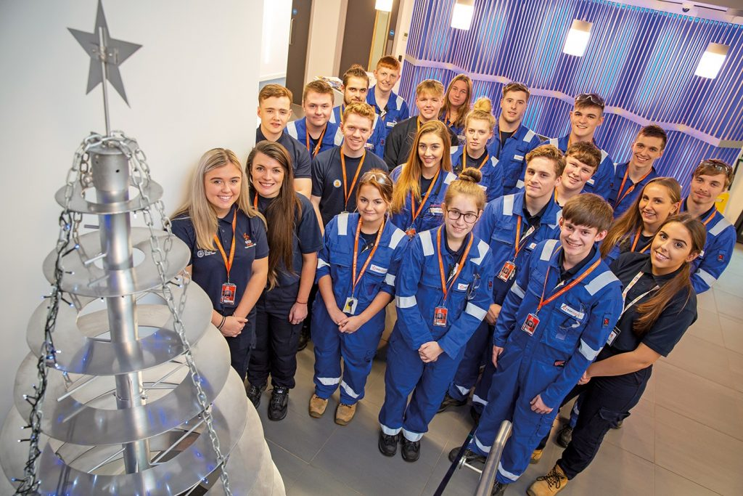
Top Tips
As Apprenticeship’s are becoming more desired, the number of candidates to any one vacancy is increasing. This means you must make your application the best!
Do this by;
Taking your time to complete an application form
Using the personal specification or any other information in the vacancy to show how you fit the criteria. Make yourself desirable to the employer!
Sell yourself and use examples to demonstrate how you have these skills
Check your application – make sure it makes sense and that it is spelt correctly. Maybe ask a family member to read through before you submit it
Remember, once it is submitted you cannot change your application, so make it the best you can the first time!
For further support, please contact the Apprentice Recruitment Team; apprenticehelp@btc.ac.uk

