Slide 1

APPRENTICESHIPS
Support with Interviews

Slide 2

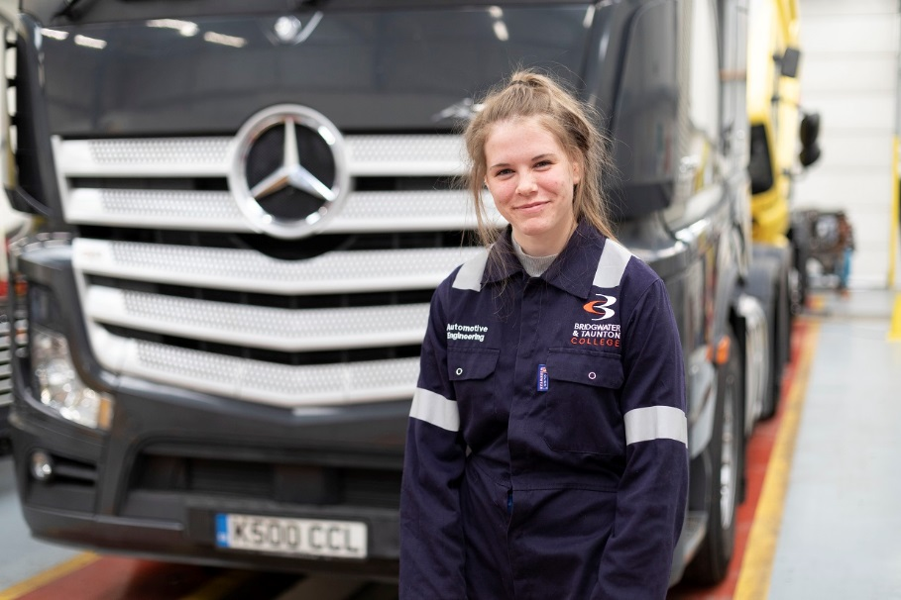
The things you need to Prepare:
Understanding the employer and the job role
Answers to questions & questions to ask
Positive mind-set on the day

Slide 3
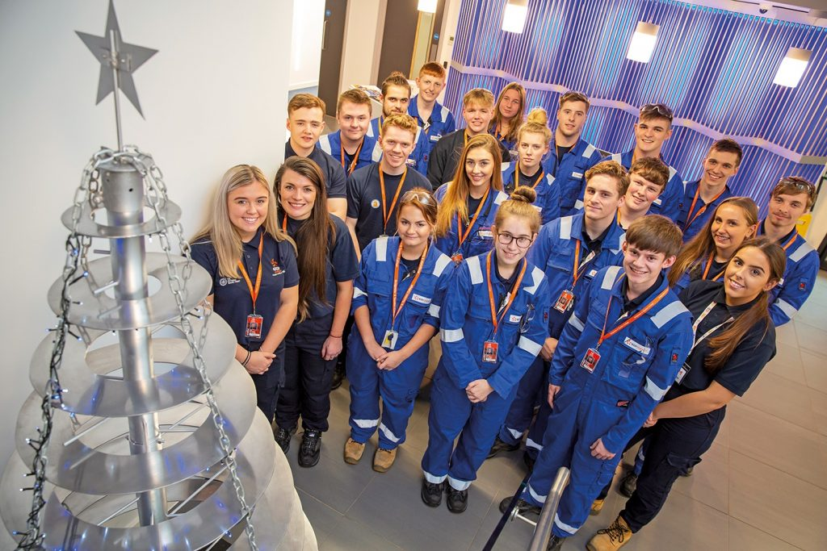
Understanding the employer and the job role:
The Employer
When invited to interview, ensure that you research details about the organisation. This will both impress the employer, but allow you to answer questions with confidence. Think about:-
- What are the aims and values of the organisation?
- Who are their customers?
- What projects are the organisation currently involved in?
Whilst completing this research, it may bring up ideas for questions you would like to ask your potential employer!

Slide 4
Understanding the employer and the job role:
The Job Role
When invited to interview, ensure that you review your application and look further at the job specification, as the employer will want to find the right person to fit those tasks!
Review your Application and prepare potential answers
- The interview might ask you to elaborate on a certain role or responsibility you’ve held.
Review the job specification or advert
- Look at the Desired Skills. Can you think of examples where you have picked up these skills?
- Look at the Personal Qualities. Can you think of examples where you have gained this experience?

Slide 5
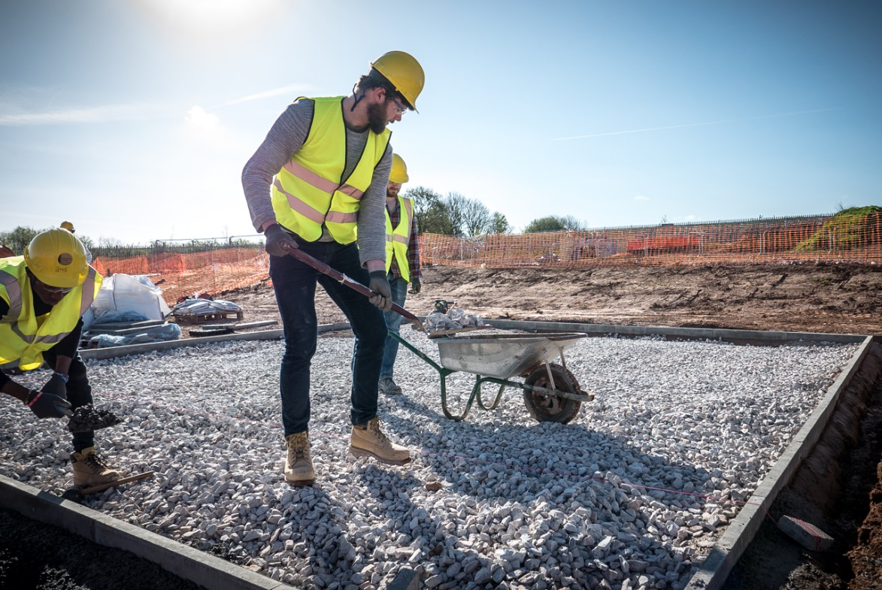
Answers to questions & questions to ask:
Preparing answers to questions
Don’t be caught out by a question on the day. Preparing answers beforehand gives you time to really think of a suitable answer
Use our Example Interview Questions Sheet, to help you prepare your answers…..
STAR Technique
When a question asks if you possess a specific skill and then provide and example. EG Problem Solving. This is called a ‘competency-based question’. The STAR technique is an excellent way to prepare and answer any potential questions

Slide 6
Answers to questions & questions to ask:
STAR Technique
S = Situation: give the interviewer a context by describing the situation.
T = Task: what was your goal or the challenge you had to overcome?
A = Action: tell the interviewer what your specific actions were. Justify your decisions and your thinking. Draw upon other related skills you used.
R = Result: the end result – make sure it shows you in a good light, even if the overall project was not a success. Did you receive any positive feedback? What did you learn?

Slide 7
Answers to questions & questions to ask:
Preparing questions to ask the interviewer
It’s inevitable that at the end of the interview they’ll ask the question ‘So do you have any questions?’ Easiest think to do is say no! But employers will love the fact that you have prepared some questions
Think of questions that show your passion and ambition for the position. Before asking, ensure that they haven’t answered them already in the interview.

Slide 8
Answers to questions & questions to ask:
Potential questions
What will my typical day look like? This will give you an idea of what your day to day tasks will be.
What training will I receive? This will show the employer your willingness to learn and give you an idea of what to expect.
Who will I be working with? (who’s in my team) Again it shows the employer your interest in the role, but also some good information around the colleagues you will be working with.
When will I attend College? As an Apprentice, there will be college days and/or assessor visits.
Prepare your list of potential questions and don’t be afraid to ask the employer if you can take you list from your bag to remind you!

Slide 9
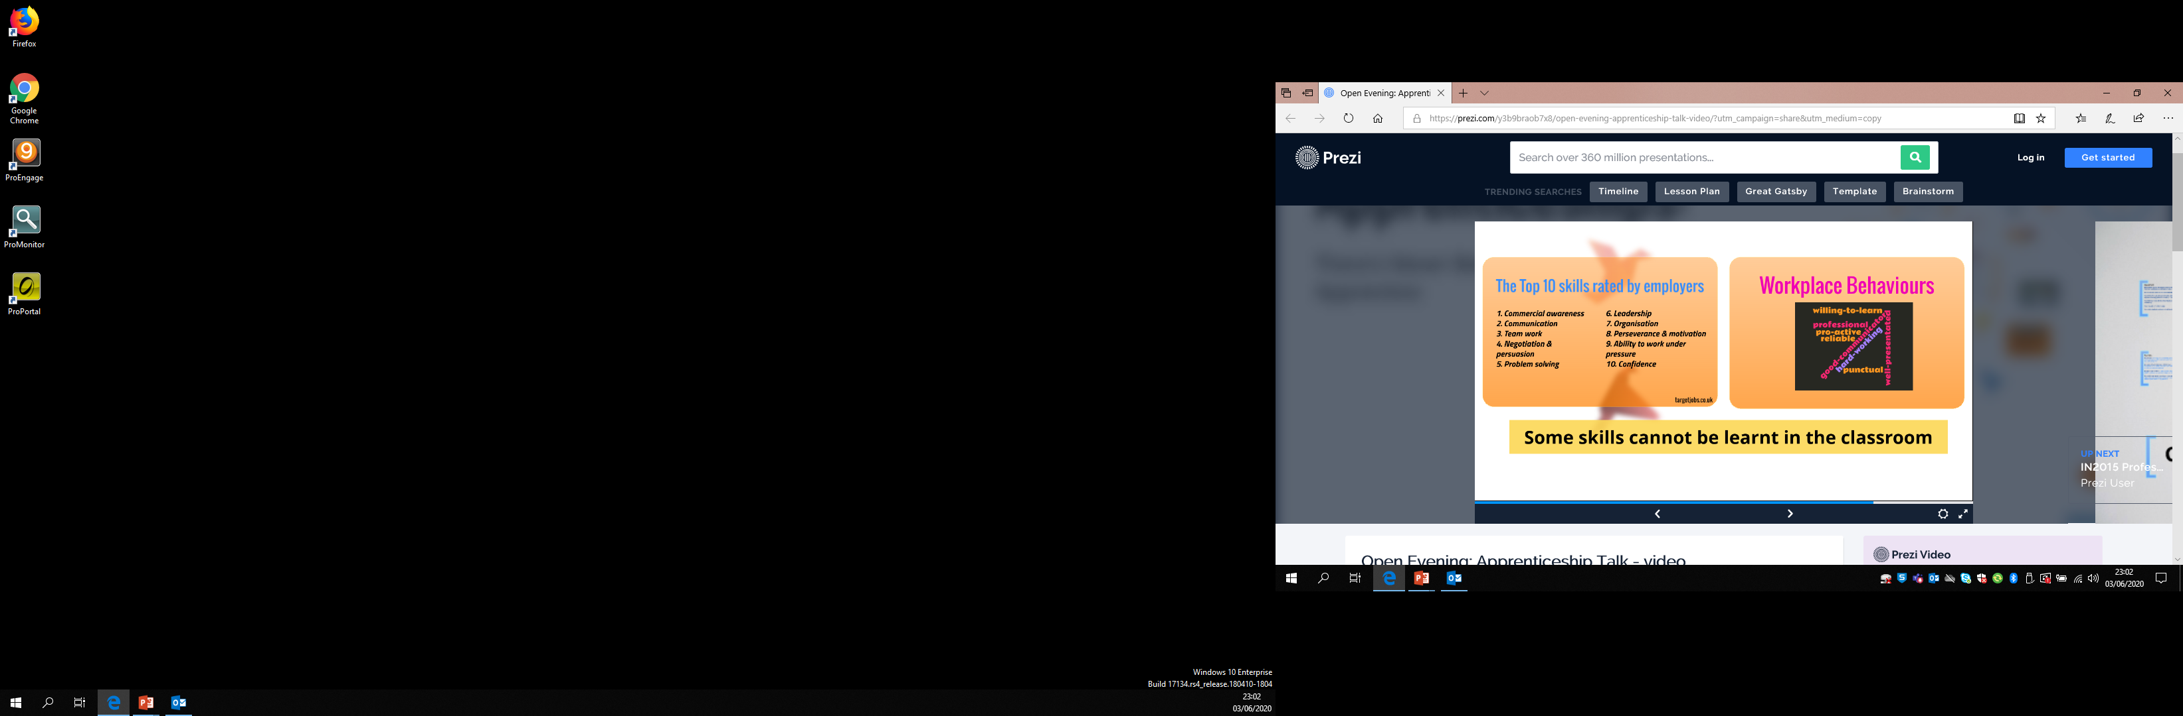

Slide 10
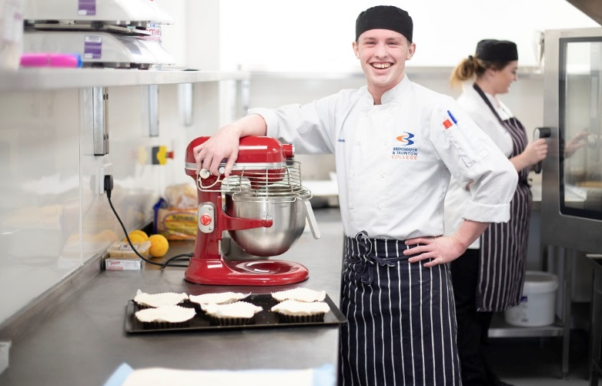
Positive mind-set on the day:
Dress Smartly
Dependent on the sector you are looking to work in, it might not be appropriate to wear ‘smart office wear’, but you must always look presentable at interview.
Arrive slightly early
Have your route planned so you can arrive early, this will help you have a look around the area and hopefully settle any nerves before you go in

Slide 11
Positive mind-set on the day:
The Interview
The employer will expect you to have a degree of nervousness. Show your personality by being yourself in the interview, they’ll want to gage your personality by the way you approach the interview.
Turn your phone off – you don’t need that distraction.
Shake hands - a sign of respect and good etiquette for meeting a person for the first time in the business world.
Eye Contact – Keep your head up and maintain eye contact as much as you can, without staring! If there is an interview panel, ensure that you give equal contact to the panel when answering all questions.
Smile - It’s quite hard to forget a happy person with a beaming smile

Slide 12
Positive mind-set on the day:
The Interview
Stand out from the Crowd
Be clear, confident and positive with your answers
Take your time to think of answers to the questions and remember your preparation!
If you think of a further example to a question, tell the interviewer later at an appropriate time of the interview
Don’t be afraid to use your notes when asking questions at the end

Slide 13
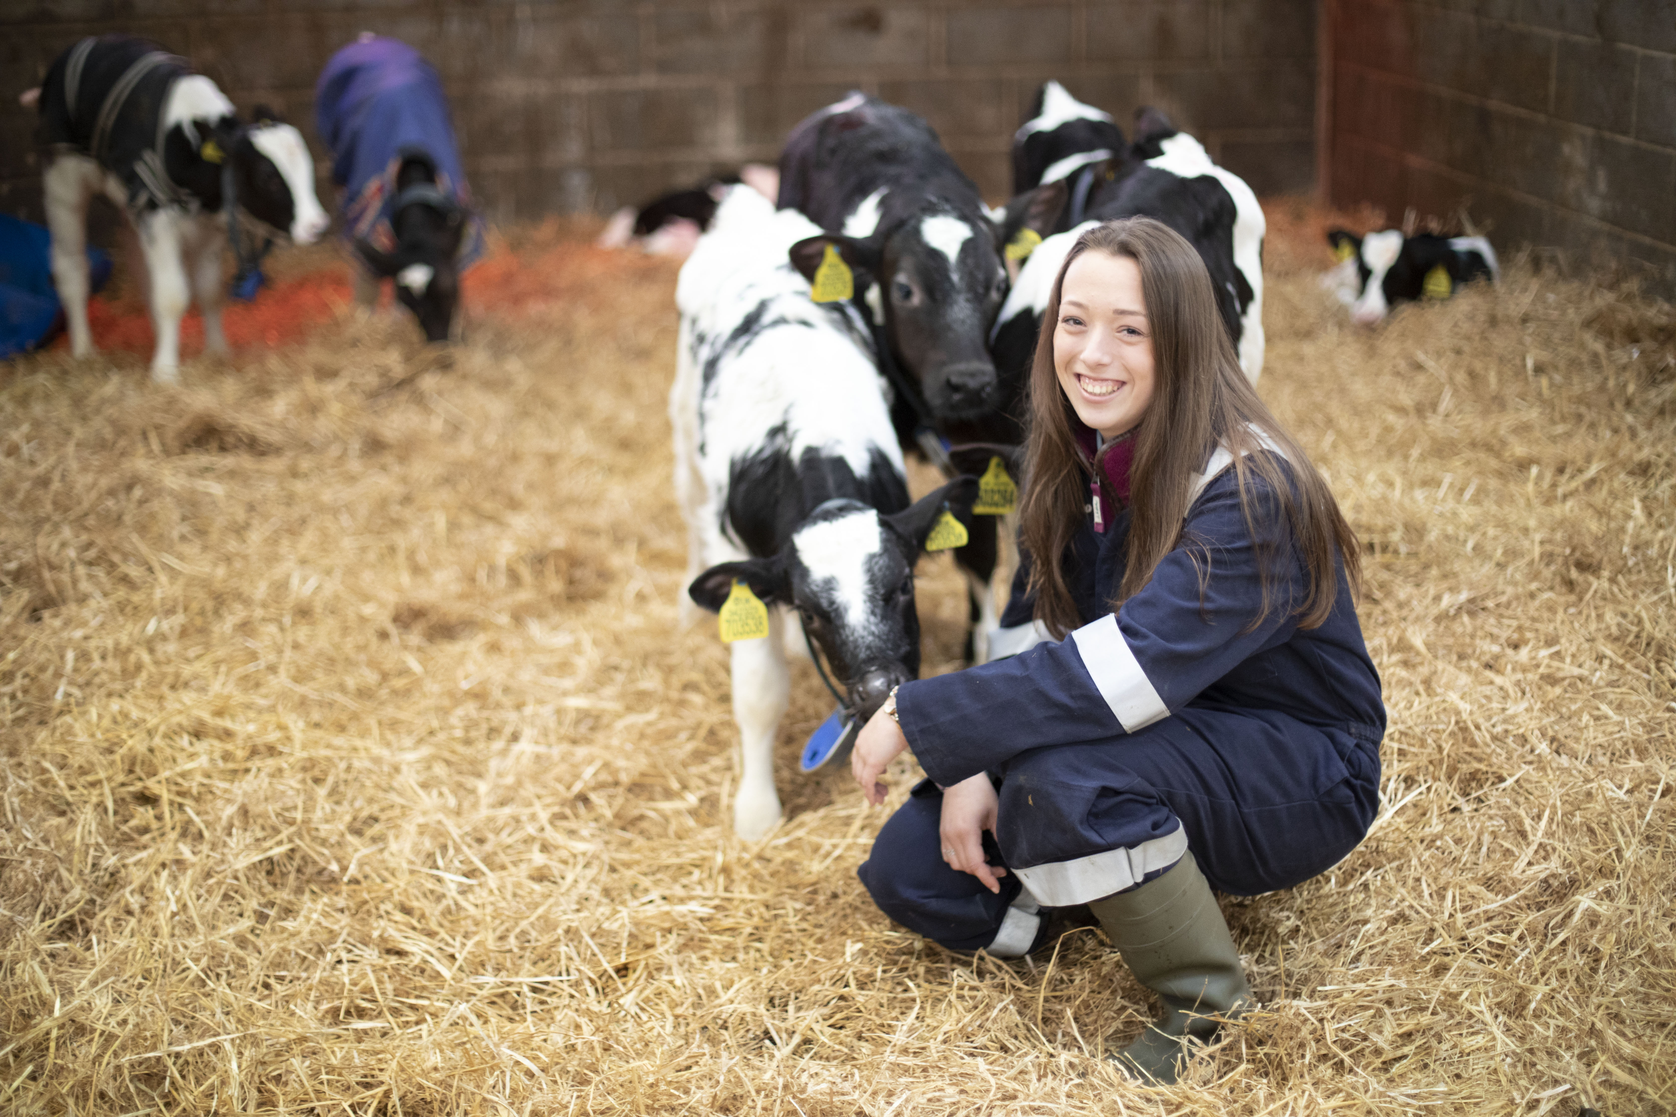
We are here to help!
We can support with Mock Interviews to help you prepare
For more guidance and support, contact our Apprenticeship Recruitment Team by emailing apprenticehelp@btc.ac.uk.

