Slide 1

APPRENTICESHIPS
‘There’s never been a better time to be an apprentice’

Slide 2

With Apprenticeships, you have options like never before!
Look Beyond
There is a National Campaign calling on young people to look beyond traditional routes into employment and explore the diversity of career options and industries now available to them through apprenticeships
National Skills Shortages
Employers are writing the Apprenticeship Standards allowing you the opportunity to develop the skills actually needed for industry

Slide 3
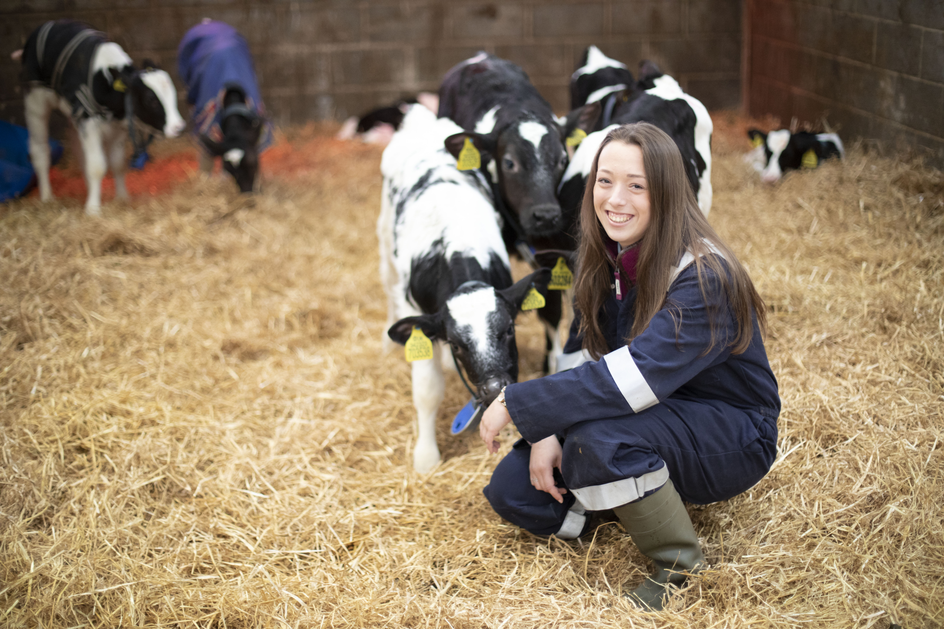
The things you need to know:
What an apprenticeship is and what’s involved
The perks of being an apprentice
Dispelling the Myths
How to secure one
Support from BTC

Slide 4
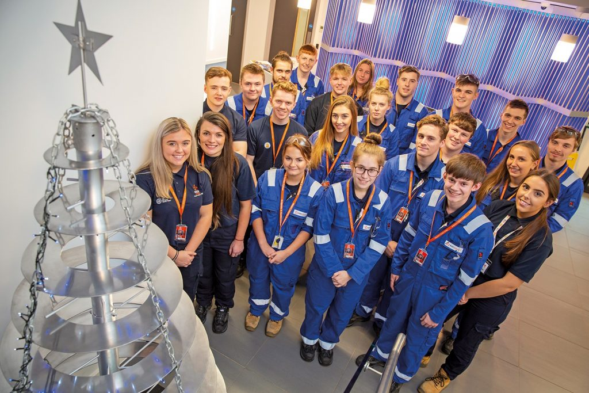
WHAT IS AN APPRENTICESHIP?
A combination of work and study
Various models of delivery
- Day Release / Block Release / Remote Study
Various programme levels to suit you, with progression routes
Over 150 apprenticeship programmes to choose from
Supported by an Assessor from the College
12 – 48 month programmes

Slide 5
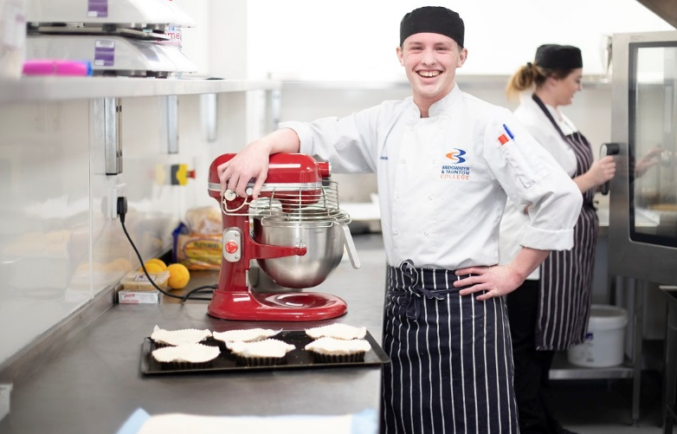
THE PERKS OF BEING AN APPRENTICE?
Earn while you learn.
- Being paid as an employee, even when you attend college
- Apprentice Minimum Wage £4.15ph+
No tuition fees. Costs are covered by the employer (with government funding)
- Debt Free! The average University students debt is over £50,000!!

Slide 6
THE PERKS OF BEING AN APPRENTICE?
All the Benefits that come with a job
- Developing skills in the workplace
- Annual leave
- Working as part of a team
Excellent employment prospects
90% of apprentices stay in employment after their course ends.
67% remaining with the same employer

Slide 7
Dispelling the Myths
1) Apprenticeship are only available in manual industries
Accountancy Countryside Management
Agriculture Early Years & Childcare
Animal Care & Management Electrical & Plumbing
Art, Design & Media Equine Studies
Automotive Fashion & Textiles
Business, Management & Human Resources Food Manufacturing & Technology
Catering & Hospitality Horticulture & Landscape Design
Civil Engineering Health & Social Care
Computing & IT Nuclear
Construction Sports Coaching & Fitness

Slide 8
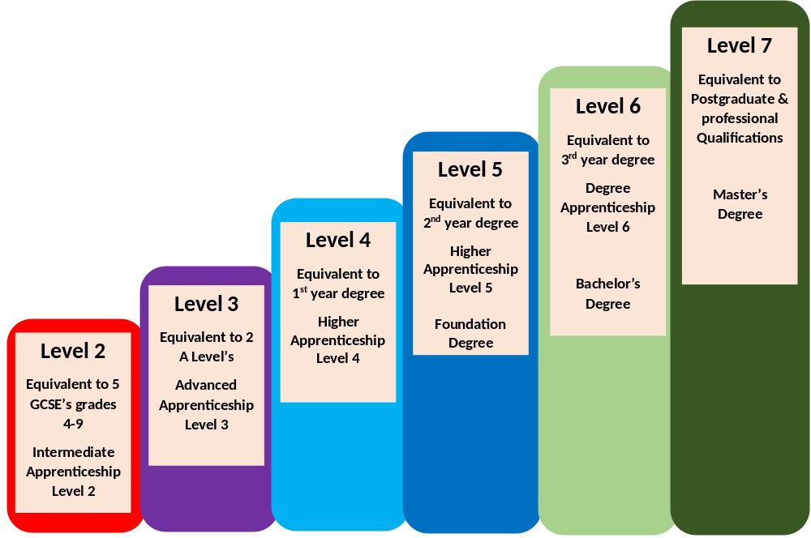
Dispelling the Myths
2) Apprenticeships are for people who don’t do well at school

Slide 9
Dispelling the Myths
3) You can only start an Apprenticeships in September
This all depends on the curriculum delivery. A number of Apprenticeship run a Roll On/Roll Off model, which means you can start your Apprenticeship at various times in the year.
So if you do start a full time study programme course and decide to move to an Apprenticeship, you can start applying for vacancies at any time.
4) Apprentices are only for School Leavers
Apprentices are for anyone over the age of 16.
A number of learners start their Apprenticeship whist in employment.

Slide 10
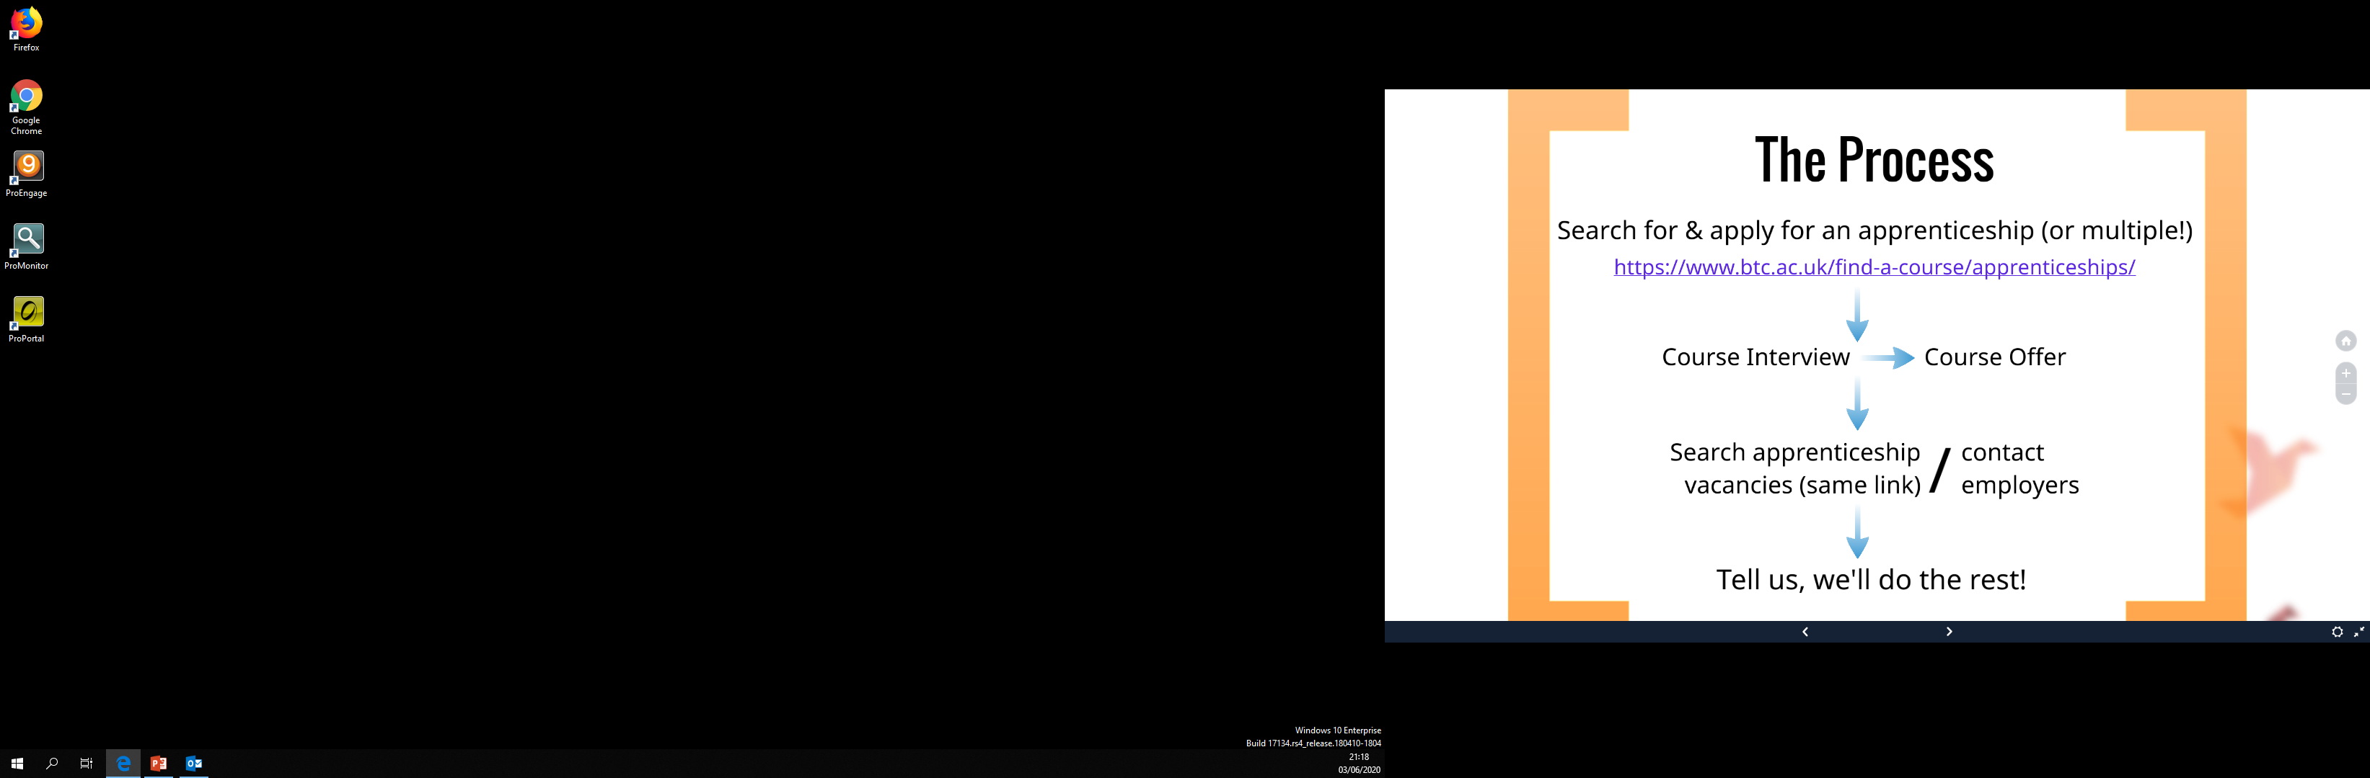

Slide 11
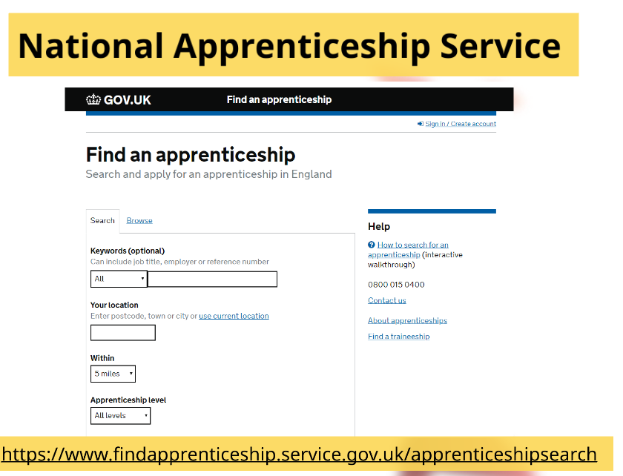

Slide 12


Slide 13

Apprenticeship Recruitment Team
Join our talent pool & we’ll email you appropriate apprenticeship vacancies
Help to apply for vacancies & interview support
One point of contact
Support through to Enrolment & Induction
Contact us:
Apprenticehelp@btc.ac.uk

Slide 14
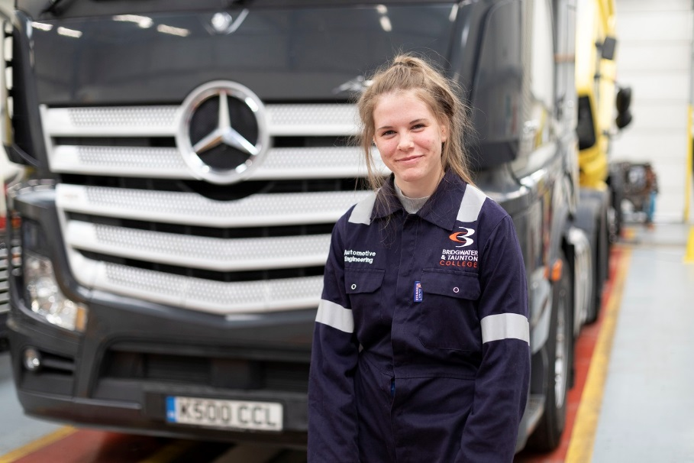
Apprenticeships are BIG right now!
The Government are pushing a national campaign
There is a HUGE demand from employers for new talent
BTC offer over 150 different apprenticeships
Last year, BTC sign up over 1300 new apprentices
The growth in apprenticeships has doubled in the last 5 years
Apprenticeships are predicted to be bigger than full-time study programmes within 5 years

Slide 15



FIND OUT MORE
Now return to the Online Showcase menu and select:
LIVE Question & Answer Session
Download the School Leavers Prospectus
Year 11s - Make an Application to BTC.

